Slide 1


Engineering Data and Design Integration – Overview
Dr Michael Gorley,
EDDI Group Leader

Slide 2
EDDI within WPMAT
WPDIV & WPBB & WPPMI (SEPOC) & WPH&CD, WPDC … ITER
Engineering Data and Design Integration
Advanced Steels
High Heat Flux Materials
Functional Materials
Irradiation Campaigns
Integrated Radiation Effects Modelling and Experimental Validation
Notes:
Comment on some direct interactions e.g. WPDIV and HHFM, and lack of direct interactions with ITER and F4E.

Slide 3
EDDI Work Breakdown Structure (2017)
1 Engineering Data & Design Integration
Lead: Mike Gorley
Total 8 ppy
0.5 ppy
1.1:
Co-ordination & Interface Activities
Lead: Mike Gorley
1.2:
Material Database & Handbook
Lead: Ermile Gaganidze
1.3:
Structural Design Criteria, Codes & Standards
Lead: Manminder Kalsey
1.4:
Material Testing
Lead: Enrico Pirelli
1.1.1:
Co-ordination
1.2.1
Material Handbook
1.3.1:
Development of new rules and methodologies
1.1.2:
Material Management Framework & Qualification
1.2.2:
Material Database
1.3.2:
DDC Structure and Release
3.5 ppy +0.5ind ppy
0.9 ppy +€60k HW
0.5 ppy
2.1 ppy

Slide 4
EDDI high level, long term, aims/goals
Implement all materials interactions (information supply) for DEMO
Developing and running a materials management framework to enable assessments and appraisals of all materials proposed for DEMO
Create, obtain data for and maintain a “DEMO material database” to enable the development of a Materials Property Handbook, eventually to include data from un-precedence conditions to match DEMO requirements [not public]
Produce and regularly update a “DEMO Materials Property Handbook” to contain all the required materials and properties required to design DEMO, statistically scrutinised with full data provenance [public, EUROfusion]
Developing design criteria to enable the design of DEMO plasma facing components (Blanket and Divertor), including unprecedented environmental conditions, going beyond any existing framework
The work started with a low level of resources and the 5 year period 2013-2018 EDDI targeted establish the group and setting foundations (templates, interactions, frameworks, skills development)

Slide 5
Key achievements
MTRL
MPH
DDC

Slide 6
EDDI: Material Technical Readiness Levels
Rationale:
Materials Technology Readiness Levels (MTRL) recommended by MAG (part of 2012 EU Roadmap) to provide a systematic overview of the technological “readiness” of materials for fusion
MTRL A-D have to be reached prior to DEMO applications
(A) „Proof of principle“ (MTRL 1-3 )
(B) „Proof of prototype application“ (MTRL 4)
(C) „Proof of industrial scale application“ (MTRL 5)
(D) „Proof of fusion application“ (MTRL 6)
(E) „Proof of DEMO application“ (MTRL 7)
(F) „Proof of fusion power plant performance“ (MTRL 8-9)
Mike Gorley | WPMAT – “Roll Out” | Garching, Germany | January 2017 | Page 6

Slide 7
EDDI: Material Technical Readiness Levels
Performance
Technology
Documentation
Measure
Requirement
Guideline
Material & Technology Topics (work areas, elements)
Materials performance: irradiation properties and fabrication
Materials technology: processing, machining, joining, coolant compatibility
Materials documentation: design conditions, safety, nuclear design codes
Mike Gorley | WPMAT – “Roll Out” | Garching, Germany | January 2017 | Page 7

Slide 8
EDDI: MTRL – Application to >30 materials
Flow diagram to overview materials progressions
Systematic questionnaire for materials assessments
Summary review document → next development steps required and key risks
Material Type
Material | IDM reference- MTRL report | MTRL
Functional Materials (10)
Amorphous SiO2 | 2MT4AM | 3
SC - Al2O3 | 2MUTN9 | 3
Polycrystalline Al2O3 | 2MX26K | 3
CVD Diamond | 2MXV7V | 3
MgAl2O4 (Spinel) | 2MXKP7 | 3
CaF2 , BaF2 | 2MXCKT | 3
ZnS, ZnSe | 2MLMH7 | 3
YAG | 2N2WXH | 3
Al / Si nitrides | 2MZ2HG | 3
Mo (Mirror) | 2MY6AS | 2
High Heat Flux Materials (15)
SP W-Cr-Ti alloys | 2MXCPR | 2
SP W-Cr-Y alloys | 2MZBF5 | 2
SPW-Cr alloys | 2MREM4 | 2
PIM W | 2N4BN2 | 3
PIM W-Y₂O₃ | 2MSASB | 2
PIM W-TiC | 2MSASB | 2
W-WC composite | 2MV8EY | 2
CVI– WfW | 2MUUV8 | 2
CVD – WfW | 2MYZLB | 2
PM – WfW | 2MT683 | 2
SiC fibre reinforced W | 2N2LGT | 2
W fibre reinforced Cu | 2MP8QC | 2
W-Cu laminate alloys | 2MTRBA | 3
W-Cu composites | 2MQUJ4 | 2
W-V laminate alloys | 2MTXQ5 | 3
Advanced Steels (4)
Advanced EUROFER for water cooled applications (grouped) | 2MT6VV | 3
Advanced EUROFER for high temperature applications (grouped) | 2N337Q | 3
Mechanically alloyed ODS steels | 2MR67B | 2
Direct gas atomised ODS steels | 2MNVXN | 1
“Baseline” materials (3)
CuCrZr | 2MUB86 | 4
EUROFER97 | 2MVWQ5 | 4
Tungsten | 2N6R7P | 3
Mike Gorley | WPMAT – “Roll Out” | Garching, Germany | January 2017 | Page 8
Notes:
Readiness for fusion application not a direct measure for performance (dependent on application)

Slide 9
Progress on EUROfusion MPH for EUROFER97
Aims
Development of a DEMO Materials Handbook for EUROFER97
Transfer/continuation/modification of existing database activities
Gap analysis and design-specific experiments/characterisation
Strategy on MPH:
EDDI will not expend effort in creating duplicate infrastructure with a reduced quality dataset drawn from literature (or other libraries, F4E..)
EDDI is focussed on the provision of basic infrastructure (e.g. templates, guidance document) for (in → easy storage) and (out ← immediate availability and easy use to the Project)
Continuous change during project life (under CDA, EDA, …. )
Mike Gorley | WPMAT – “Roll Out” | Garching, Germany | January 2017 | Page 9

Slide 10
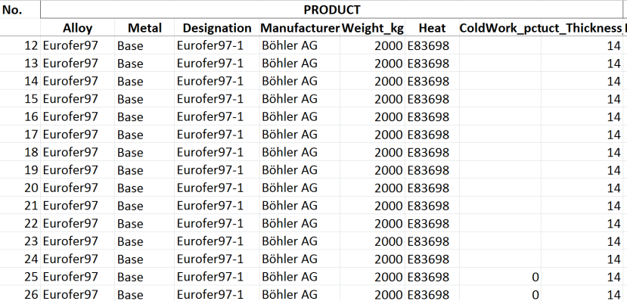
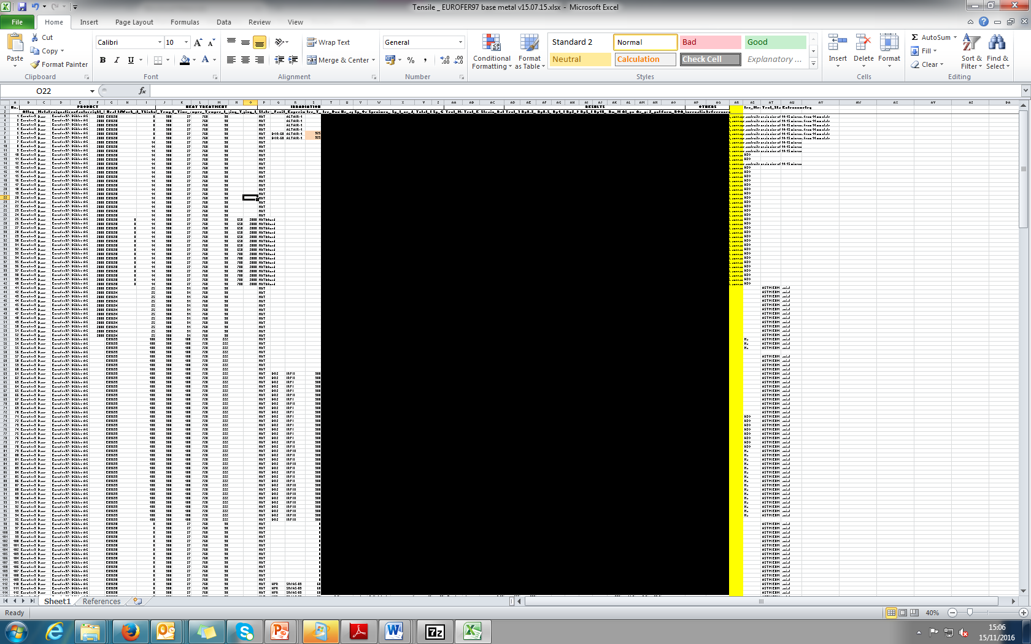
Progress on EUROfusion MPH for EUROFER97
EUROFER97 Database
Tailored materials database for “raw materials testing data” created and populated (>1800 records)
Statistical and provenance screening of all materials data to ensure quality standards achieved
Data drawn from existing available databases from KIT, CEA, old EFDA campaigns
…
Mike Gorley | WPMAT – “Roll Out” | Garching, Germany | January 2017 | Page 10

Slide 11

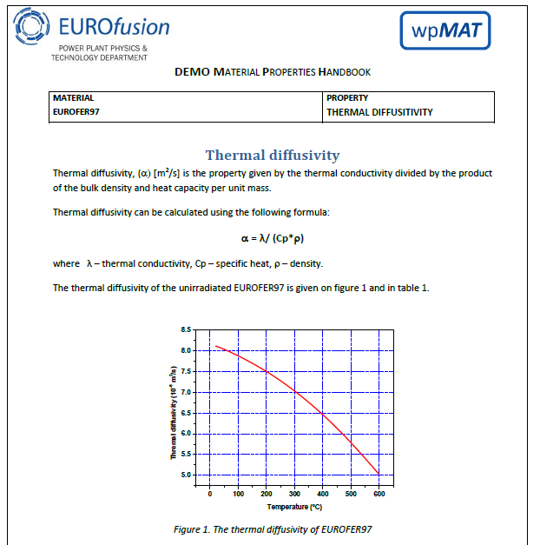
Progress on EUROfusion MPH for EUROFER97
“EUROfusion“ Material Properties Handbook - 1st relased in March 2016 (2nd release due ~March 2017)
Properties include:
Chemical composition, Density, Yield Strength, Tensile Strength, Elongation, Reduction of Area, Young‘s Modulus, Poisson ratio, Charpy Impact Energy, Fracture Toughness, Fatigue-Crack-Growth-Rate, Fatigue, Creep, Swelling, Ratcheting, Linear Thermal Expansion, Thermal Conductivity, Specific Heat, Melting Temperature, Electrical Resistivity, Magnetic Saturation, Remenant Magnatisation, Coercive Field.
Providing design data based on RCC-MRx, e.g. S_{m}
More non-irradiated data required
No weldment data included
Very limited irradiation modification effects are captured and no “spectrum” distinction currently considered; placeholders for WPMAT-IRRAD data in database but more data required)
Mike Gorley | WPMAT – “Roll Out” | Garching, Germany | January 2017 | Page 11

Slide 12
Reminder: EDDI - Grant deliverables (MPH)
WP | ID | Title | Due date
MAT | D25.14 | MAT.D06.1 MPH: (1st formal release) | Mar-16
MAT | D25.15 | MAT.D06.2 MPH: (2nd formal release) | Jun-17
MAT | D25.16 | MAT.D06.3 MPH: (3rd formal release) | Dec-18

Slide 13
DEMO Design Criteria (DDC)
Mike Gorley | WPMAT – “Roll Out” | Garching, Germany | January 2017 | Page 13

Slide 14
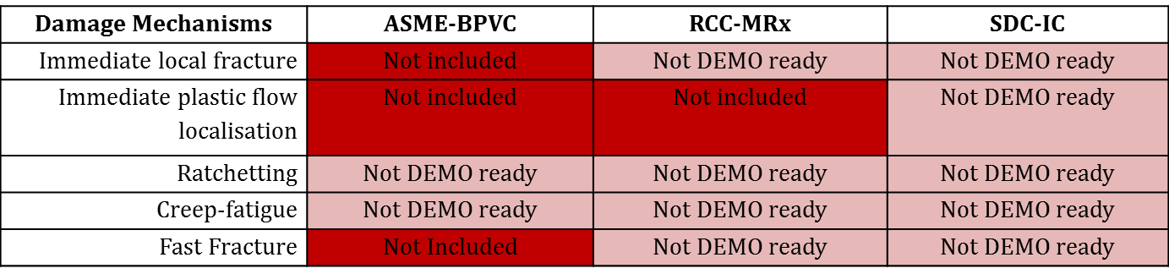
Structural Design Criteria, Codes & Standards - Why Fusion requires significant developments
“As of today, there is no single set of C&S that fulfils all the requirements for the design and construction of a fusion reactor and in particular the BB. “
EFDA D 2MER4B - J. Aubert, WPBB, 2016
Examples from current nuclear design codes
Adapted from M. Porton (ISFNT 2015) and G. Aiello (EDDI-F4E interfaces 2016)
Mike Gorley | WPMAT – “Roll Out” | Garching, Germany | January 2017 | Page 14

Slide 15
EDDI – DEMO Design Criteria Objectives
EDDI
long-term effort to provide
DEMO Divertor and Blanket design Projects with
effective design validation criteria:
Cover key damage mechanisms
Cover key modifying effects (e.g. irradiation)
Cover key joining techniques
Account for structural and armour elements
Provide appropriate level of conservatism
Provide clear unambiguous assessment rules
Align with modern FEA packages
Demo Design Criteria
Material Testing (Unirradiated)
Material Database & Handbook
Mike Gorley | WPMAT – “Roll Out” | Garching, Germany | January 2017 | Page 15

Slide 16
DDC COORDINATION: 2016 Summary
Coordination
DDC Coordination
DDC Development
DDC Industrial Review, Future developments, Classifications
1. Fill Priority Gaps
Brittle Fracture Rule development
Creep Fatigue Rule development
Armour and Joint Design Assessment
2. Improve
Technical Content
Fatigue initiation and crack propagation
Fatigue advanced modelling
Ratcheting rules
Plastic Flow Localisation Rule development
3. Improve use-ability
Creep Fatigue assessment tool
4. Educate the User
Divertor and Blanket Case Studies
Damage Mechanism Physical Examples
DDC Workshops
Slide 16
Mike Gorley | WPMAT – “Roll Out” | Garching, Germany | January 2017 | Page 16

Slide 17
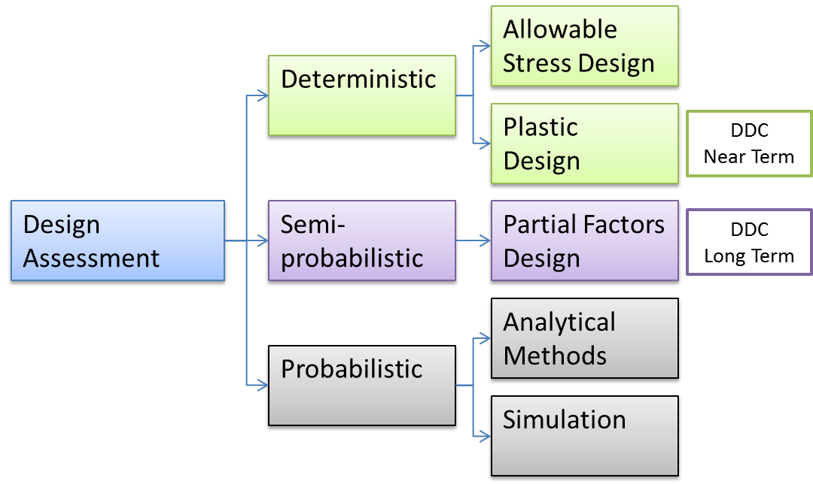
Progress on DEMO Design Criteria
M. Kalsey, EDDI – Designers Workshop KIT 3-4nd March 2016
DDC contribution/oversight to “procedures and methodologies” for BB and DIV design during “pre-CDA” and CDA are NOT established, despite working relationship
Mike Gorley | WPMAT – “Roll Out” | Garching, Germany | January 2017 | Page 17

Slide 18
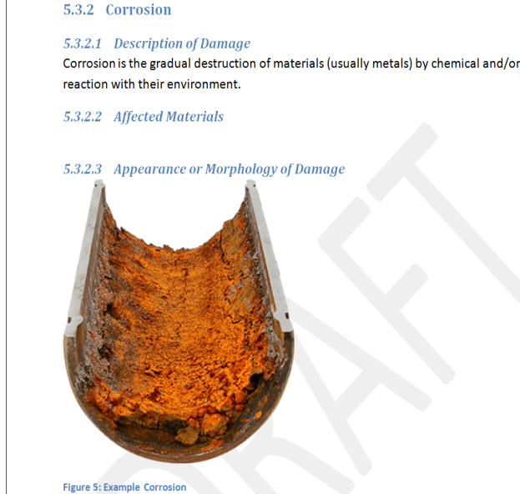
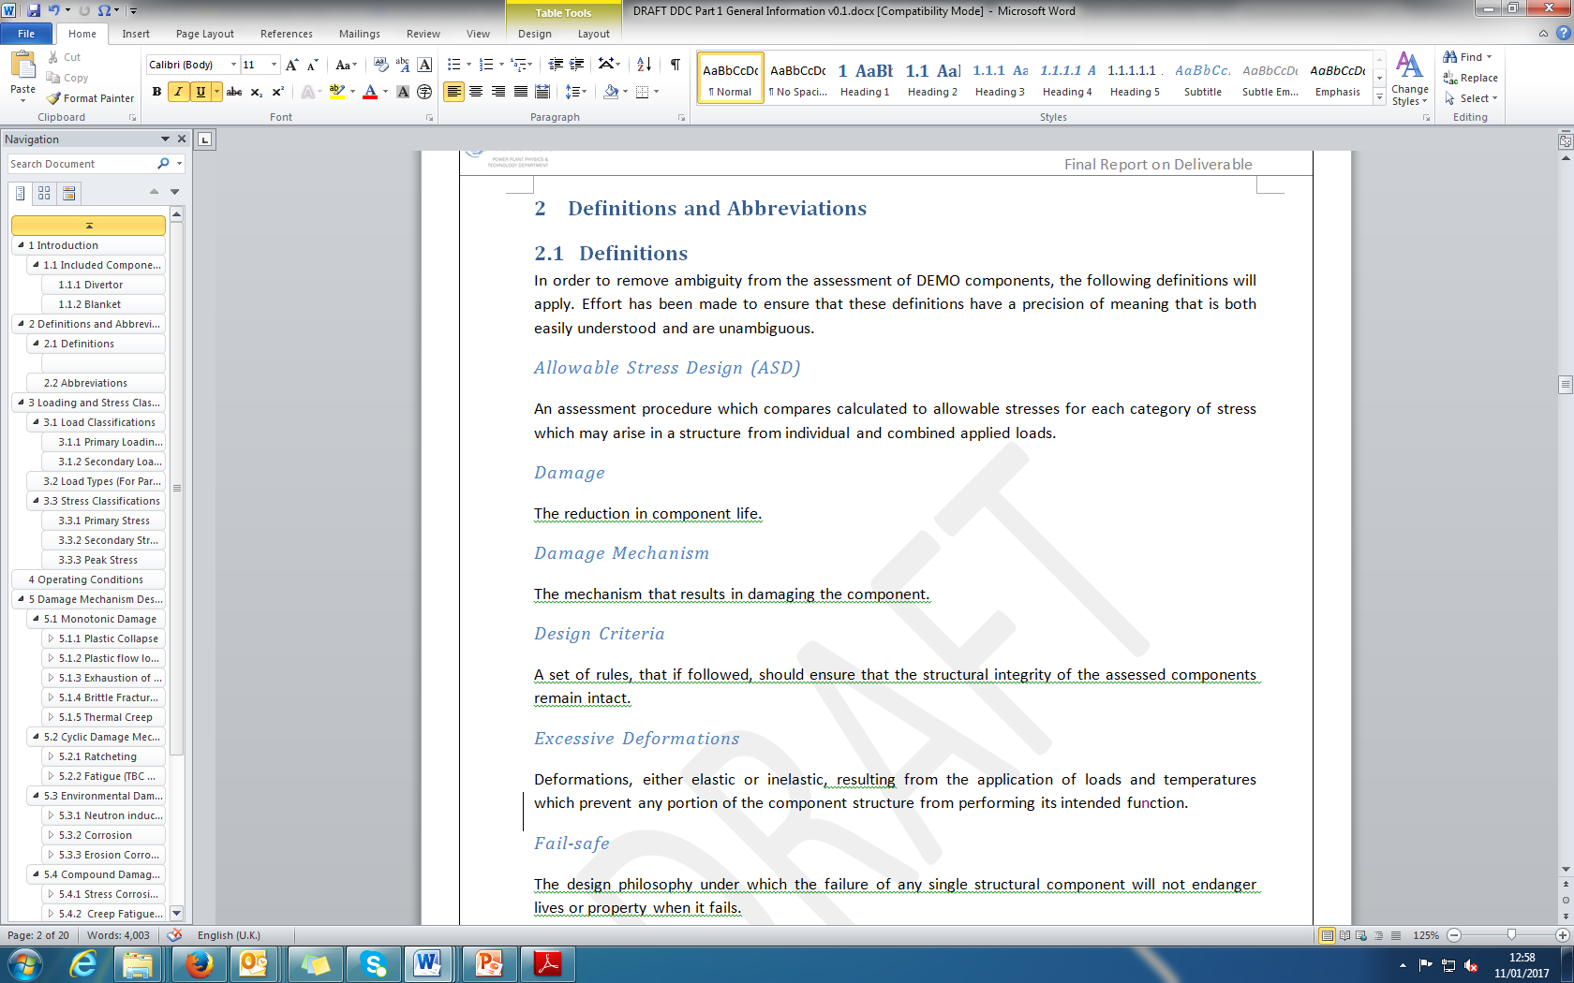
Progress on DEMO Design Criteria
“DEMO Design Criteria“ Intermediate report (structure) – release imminent
Structure includes:
1. General Information
2. Design Assessment
3. Material Data
4. Example Calculations
5. Rule Justifications
NO joining, corrosion, or irradiation modifying effect included to date
Key requirement for peer review and evaluation from EUROfusion design teams as well as international community
Mike Gorley | WPMAT – “Roll Out” | Garching, Germany | January 2017 | Page 18

Slide 19
Progress on DEMO Design Criteria
Damage Mechanisms | From existing C&S, rewritten. | From existing C&S, with technical modifications. | Newly developed
Monotonic Damage
Plastic Collapse | ASME VIII rule identified, needs review
Plastic Flow Localisation |  | Drafted, Under development
Exhaustion of Ductility |  | Drafted, Under development
Brittle Fracture | Drafted, needs to be reviewed by DME
Thermal Creep | Drafted, needs to be reviewed by DME
Cyclic Damage
Ratcheting |  |  | Under Development
Fatigue |  | Under Development, needs to be drafted by DME | Under Development
Environmental Damage
Swelling
Corrosion
Erosion
Compound Damage
Stress Corrosion Cracking
Creep Fatigue |  | Under Development Needs to be drafted by DME

Slide 20
"Proposed" DDC Requirements
The DDC requirements have been extracted from the DEMO Roadmap & MAT PMP.
Deliver validated and tested design criteria for the BB and DIV teams by June 2023.
Engage SDO organisations in the development of the design criteria.
Engage industry in the development of the design criteria.
Develop DEMO design criteria that are applicable to the baseline materials.
Ensure that the DEMO Design Criteria takes advantage of ITER experience.

Slide 21
"Proposed" DEMO Project Interaction
To ensure an appropriate level of interaction is maintained the following is proposed:
An EDDI representative should participate in all BB, DIV & SAE team meetings.
A BB & DIV representative should participate in all EDDI team meetings.
A BB & DIV representative should participate in all DDC progress meetings.
The EDDI team shall hold an annual workshop to disseminate progress within the MAT project to the wider DEMO community.
M. Kalsey | EDDI Planning Meeting | 17/1/2017

Slide 22
Many Thanks

Slide 23
Extra slides

Slide 24

Initial ideas on 2017 high level aims
Establish and gain approval for draft EU roadmap for Design Criteria in fusion
Develop “draft” MPH chapter for “baseline” Tungsten & extend FM MPH
Continue to grow WPMAT group interactions with greater establishment of MTRL and materials Database
Better interaction with DEMO design via SEOP role and increased collaboration with DIV and BB
Conclude and summarise multiple test request to support rule development/validation.
Increase international and industrial collaborations as much as possible
Start establishing collaborative projects with IREMEV group
Collaborations with US on materials design interface

Slide 25
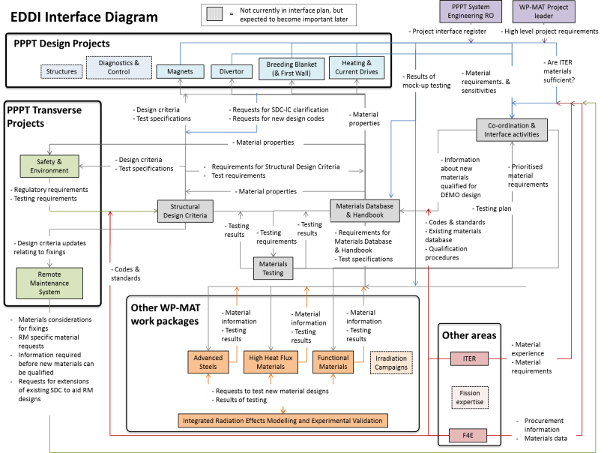
1.1 EDDI interfaces
SEPOC
DEMO Design Criteria & MPH
Materials Evaluations
Materials Data/information
Notes:
Strcutre to the workshop is to have a split with today focusing on a summary of EDDI to bring everyone up to spedd and enable us to highligh some of the efforts that are ongoing. This is very much seen as the trial for a first wroshop that will hopefully be replicated several times int eh coming years as we develop new tools and have specific important updates to provide tot eh designers. This first day then covers several areas.

Slide 26
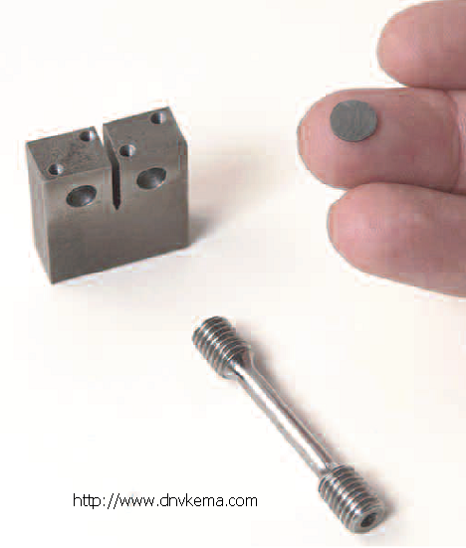
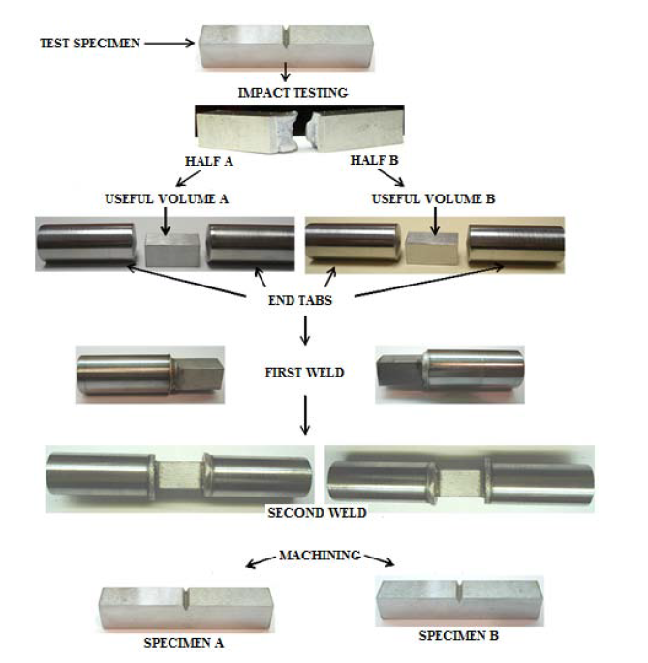

Lessons from fission surveillance programmes
A flexible design and an amendable concept to consider new advances in materials science/engineering and to implement state of the art mechanical materials testing
Retain sufficient amounts of limiting materials in the materials archives
M. Serrano, 2015
Complementary data to understand the underlining materials degradation mechanisms
state of the art materials testing techniques and microscopy
specimen reconstitution techniques
advanced damage and micromechanical modelling
Small Specimen Test Technology
Specimens reconstitution
ASTM E1253

Slide 27
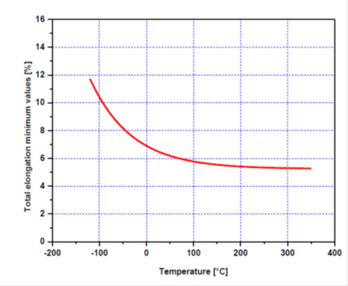
Eurofer97 - Total Elongation Irradiated values
Figure 2. Values of total elongation measured on differentially irradiated EUROFER97 in the function of the testing temperature
Condition, curve type | Temperature range | Equation
Unirradiated, average TE | -164 ≤ T ≤ 700°C | 22.75684-0.02355x-3.19787⋅10⁻⁶x² +9.89573⋅10⁻⁸x³
Unirradiated minimum TE (ITER SDC-IC) | -164 ≤ T ≤ 700°C | 22.75684-0.02355x-3.19787⋅10⁻⁶x² +9.89573⋅10⁻⁸x³-1.96⋅3.58
Dose <3 dpa; T_{irr}<350°C trend curve | -150 ≤ T ≤ 500°C | 14.41558-0.02209x+3.77228⋅10⁻⁵*x² +5.41726⋅10⁻⁸x³
Dose =4-6 dpa; T_{irr}<350°C trend curve | 325 ≤ T ≤ 330°C | 11.825
Dose =7-9 dpa; T_{irr}<350°C trend curve | 20 ≤ T ≤ 400°C | 11.4134-0.00214x
Dose =13-15 dpa; T_{irr}<350°C trend curve | 20 ≤ T ≤ 350°C | 9.77174+0.00338x
Dose =16-18 dpa; T_{irr}≥350°C trend curve | 400 ≤ T ≤ 450°C | -106.3725+0.28975x
Dose =30-42 dpa; T_{irr}<350°C trend curve | 20 ≤ T ≤ 350°C | 11.55066-0.00184x
Dose =70-78 dpa; T_{irr}<350°C trend curve | 20 ≤ T ≤ 350°C | 11.11167-0.00449*x
Notes:
W10PF: 0.7µm powder + source of carbon (phenol formaldehyde resin)
W10G: 0.7µm powder + source of carbon (graphene)

Slide 28
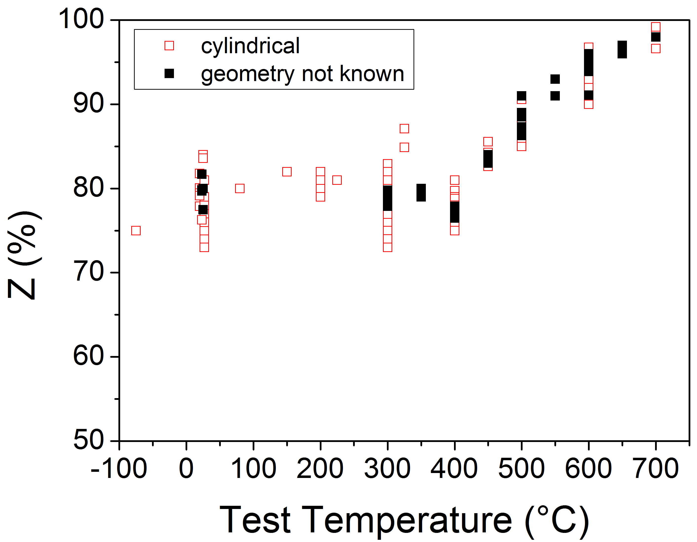
Eurofer97 - Reduction of Area, Impact of specimen geometry
Material Identification | √
Specimen Identification Missing identification labels Missing specimen orientations Missing specimen geometries | Not full
Irradiation Condition | √
Test Missing test parameter (e.g. strain rate) Missing test environment | Not full
No clear influence of the specimen geometry within the available database
specimens with unidentified geometries also included in the analysis

Slide 29
Blanket damage effects from WPBB review
“… the blanket will have to withstand the simultaneous combination of high temperature operation (creep damage), neutron irradiation (change of materials properties) and strong pulsed operation with high thermal gradients (thermal fatigue, creep-fatigue interaction). Moreover, the materials used are new to the nuclear industry …”
EFDA D 2MER4B - J. Aubert, WPBB, 2016

Slide 30

DDC COORDINATION Strategy
Following the Demo Design Criteria review meeting with F4E, SAF, DIV, BB, it was decided that a DDC strategy document is created to clearly define the following:
DDC Objectives aligned with the DEMO Roadmap Objectives and Timescales
DDC team structure
Define DDC Roles and Responsibilities, ensuring a limited overlap with BB, DIV, SAF and ITER
Define an interaction map between all interested parties (EDDI, BB, DIV, SAF, ITER, Industrial Partners, Regulators)
Define response to a number of combinations of Safety Classifications and Regulators.
Create an alignment between MPH & DDC, and then move forward together.
Can the DDC become an European standard (EN) or shall it eventually feed in to an existing Code
The draft of this report is expected to be completed by the end of Nov (not a deliverable). Strategy meeting to be held in early December.

Slide 31
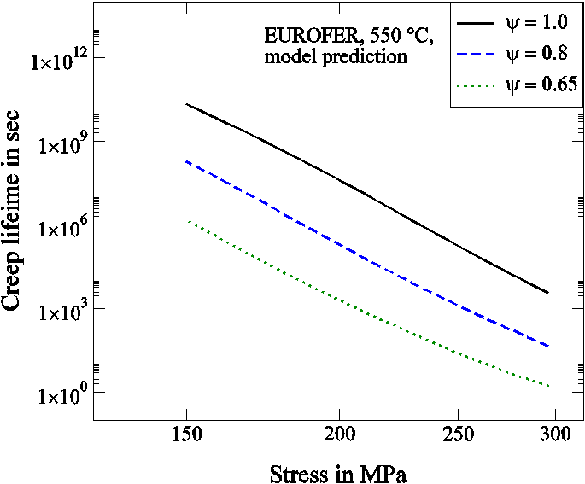
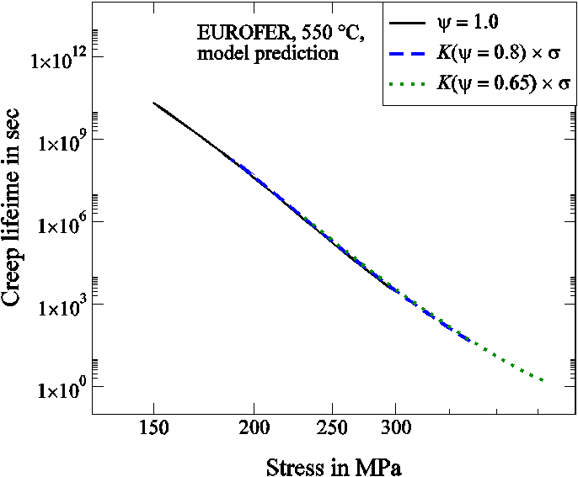
Progress on DEMO Design Criteria
Example of progressive modification – creep fatigue
Current ASME code uses 0.1,0.1 tip for creep fatigue interaction diagram to accommodate for effect of softening of FM steels
New approach, apply Ψ factor to accommodate and reduce conservative tip point to 0.3, 0.3 (or beyond)
Currently obtaining data to validate rule is acceptable, input to DEMO design criteria and beyond.
New design allowables
Ψ
Calculating Ψ
Mike Gorley | WPMAT – “Roll Out” | Garching, Germany | January 2017 | Page 31

Slide 32
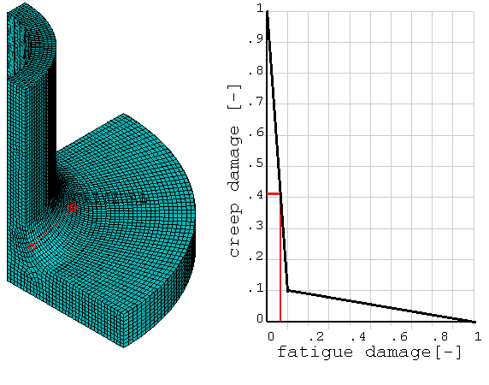
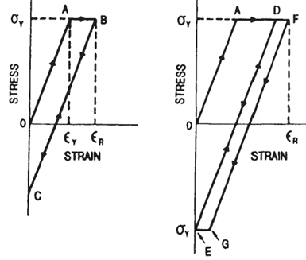
Progress on DEMO Design Criteria - tools
DDC - Creep Fatigue Assessment
Supports the evaluation of creep fatigue damage in analysis software
Utilises database on Eurofer97, additional data requirements identified to improve the tool
Visually highlights critical pathway to enhance rapid re-designs of components
M. Mahler, EDDI – Designers Workshop KIT 3-4nd March 2016
DDC - Ratcheting
“2 step method” for rapid determination of ratcheting failure using in-elastic analysis procedure
Successfully tested on Divertor components to enable rapid down-selection and re-design
J. Gardiner, EDDI – Designers Workshop KIT 3-4nd March 2016
Mike Gorley | WPMAT – “Roll Out” | Garching, Germany | January 2017 | Page 32

Slide 33
EDDI extra images
2011
2012
2013
2014
2015
2016
Beyond 2017
DEMO OPTIONEERING
DEMO CONCEPT DESIGN
AFCEN
Modify and extend an existing fission code to cater for fusion's unique in-vessel needs: Evolution of RCC-MRx?
Nuclear Fusion Power-plant
Fusion specific design criteria work on timeline
ASME
Create a new fusion specific code: ASME III Division 4
Near Term: Develop DEMO Design Criteria to support DEMO design
EuroFusion
Long Term: tbc
May 2015
Structural Design Criteria for DEMO
Structural Design Criteria for DEMO

Slide 34
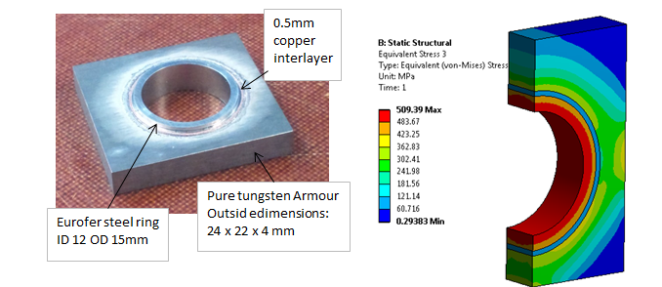
TESTING 6.…verify residual stress…
2015 work: crack growth prediction is difficult particularly under non-proportional (principal stress direction oscillates during load cycle)
Residual stress is one of the causes of non-proportional stress in PFC. (multi CTE materials cooled from high temp joining process)
Mock-up samples of monoblock type PFC have been manufactured specifically for residual stress testing
Application submitted to ISIS for neutron diffraction residual stress measurement

Slide 35
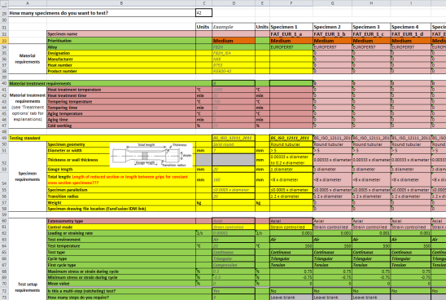
1.4 - Materials Testing
Materials testing campaigns to support engineering design and materials database. (Explicitly for non-irradiation testing)
Enable acquisition of materials data to fill: gaps in the database & Missing data validation to support new design rules
Work to date:
Development of a EDDI testing procedure
Round robin testing campaign using Eurofer 97 (ongoing)
Testing campaigns to support new design rules
Notes:
Comment on nesesity for a slow start to the testing due to EDDI formative years but current extrapolation of testing campaigns to support critical DEMO data.

